Slide 1
REFUGEES, MEDICAL AID BUDAPEST August-September, 2015
ASSOCIATIONS OF HUNGARIAN PRIMARY CARE PAEDIATRICIANS

Slide 2
Registration - Border points
Around 300 000 immigrants and refugees – mostly from Afghanistan, Pakistan, Bangladesh, Iraq, later from Syria, have entered to Hungary during this summer. After crossing border they were transported to guarded camps, where doctors employed by the police, examined them superficially. Most of the immigrants refused registration in Hungary, as they didn’t want to stay in Hungarian refugee camps for years. Only those, who were registered, got license to the same health care as citizens have.

Slide 3
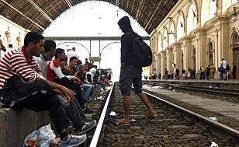
transportation
From the border points all immigrants were transported by trains to Budapest, where they could change to an other train toward the refugee camps, or toward Austria/Germany.

Slide 4
Help actions
Since (outside the few official refugee camps) Hungarian state did not provide any care for them, civilians started to organize help actions. Food, water, clothes was given in the “transit zones” of the bigger railway stations, but medical help was provided only by very few enthusiastic colleagues.

Slide 5
Medical assistance
Seeing the situation of the exhausted, dehydrated refugees, at the beginning of August, as the only official medical organization, the Associations of Hungarian Primary Care Paediatricians decided to provide medical assistance. We made a call to our members in the capital, in which volunteer doctors, nurses, assistants were recruited. In a very short time more than 60 volunteers expressed willingness to help.

Slide 6
Daily consultation
We got a tent and some basic equipment from the Hungarian Red Cross, but we used mainly our own resources. The tent and soon after two container by the Baptist Charity workers was placed at one of the most frequented point, at Budapest Western Railway Station, where we had a daily consultation in every evenings and sometimes in early morning, when trains with refugees arrived.

Slide 7
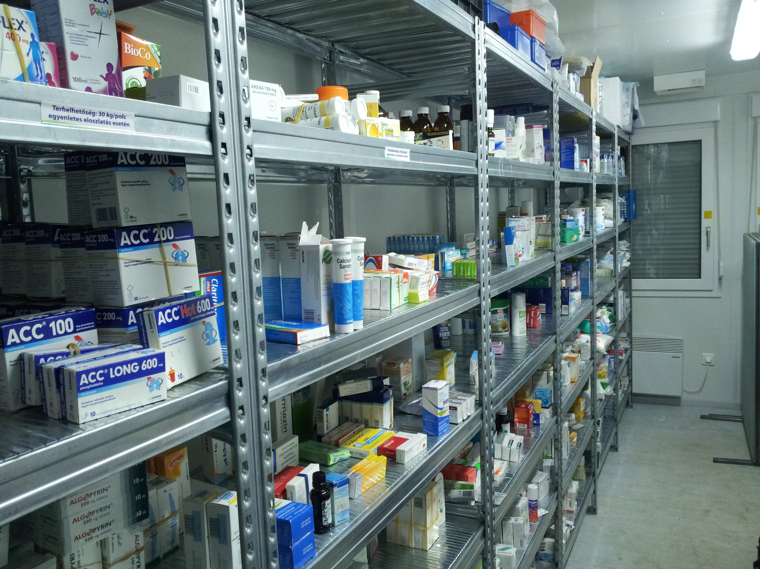
Medicine
Of course we needed much more medicine than we thought, mainly antibiotics, painkillers, bandage etc.; therefore a call was made on the Facebook for donation. The generous amount of money donated by civilians, made it possible that not only our group, but also all doctors working as volunteers at other places in the country, could get all medicine, bandage, disinfectants, rubber gloves etc. they needed.

Slide 8
PCPs, residents, etc
The main problems and complaints we were confronted were dehydration, upper respiratory tract and enteral infections, minor injuries and skin infections. At the beginning only members of our association, thus primary care paediatricians made the consultations, but very soon residents, doctors, specialists of all medical disciplines joined us. NGOs from the US, UK, Germany or France and our friends from ECPCP also expressed their willingness to help us, but as you all know the fence built on our southern borders stopped influx of immigrants.

Slide 9
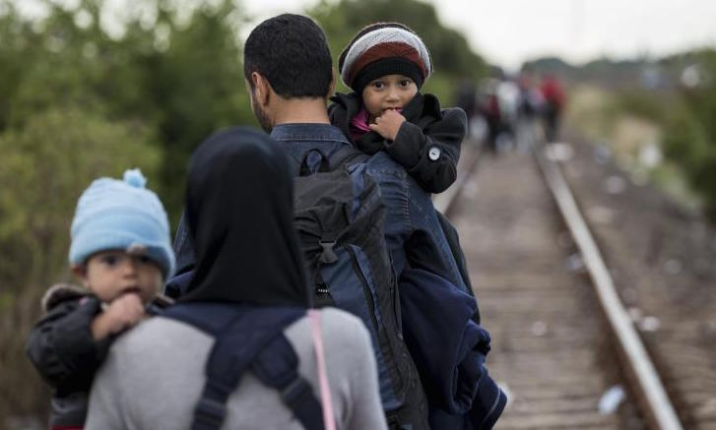
today
Some members of us continued their work in Serbia and then in Croatia, at the moment we are going to send our volunteers to Slovenia, where there are thousands of refugees.

Slide 10
Unaccompanied children
In this moment we have only few hundreds asylum seekers in our official refugee camps.
8.500 unaccompanied children under 18 yr in 2015,
95%: 14-18yr, 90% from Afghanistan,
4% from Syria
They were sent into children’s home. They get all medical care they need, including catch-up vaccination, they are going to school.
I wonder if there is anyone in Hungary, who wants to determine their exact age by radiological examination.
Now we have only 60 (!) in childcare...

Slide 11
Summary
The European crisis is not over, influx of migrants did not stop, and winter season is approaching.
We can’t forget what Gottfried wrote:
“…there is an enormous demand now for help and medical support…”
or what Shimon says:
“… Regardless of the political issues involved in the matter countries should have in mind that health is a right and not a privilege…
… the 1951 Refugee Convention states that refugees should enjoy access to health services equivalent to that of the host population…
…As Pediatricians and as Europeans but most of all as Humans we cannot stand by the present tragedy of refugees…”

Slide 12
we can’t do anything else, than taking into consideration what Statement of WHO –European Regional Office states:
Health challenges of migrants need migrant sensitive health system, with careful planning, training of front line health care workers, and strong collaboration between official and NG organizations.

