Slide 1
Prevention in primary paediatric care - SLOVENIA
Margareta Seher Zupančič*, Polonca Truden-Dobrin**
*Children and school children health services, Health care center Velenje, Slovenia
**National institute of public health

Slide 2
Current preventive health care programmes at primary level in Slovenia (financed by obligatory insurance scheme)
Defined by the Rules on preventive health care at the primary level
(Official Gazette, No. 19/1998 ):
Children and youth preventive healthcare at primary level
Newborn preventive healthcare programme at the maternity hospitals
Adult preventive healthcare at primary healthcare, National programme on primary prevention of cardiovascular diseases – since 2002, RA – since 2011
Cancer screening programmes: DORA, ZORA, SVIT
Home visiting service
Reproductive preventive healthcare
Oral health preventive health care
Preventive healthcare for athletes
Occupational preventive healthcare.
Notes:
In our health care system, many elements actually use the life course approach. For example, we have well developed preventive programs in the area of reproductive health and child and adolescent health. The programs are published in the Official gazette; therefore they are a part or normative framework. In the programs, we use universal approach and we consider this an important mechanism for reducing inequalities in health, as the programme is available for everyone through the national obligatory insurance.
However an evaluation carried out by the National Institute of Public Health showed that there are children and in particular adolescents that are left out of the program. A working group financed by the Norwegian financial mechanism is now working on improvements of the program in order to increase the coverage.

Slide 3
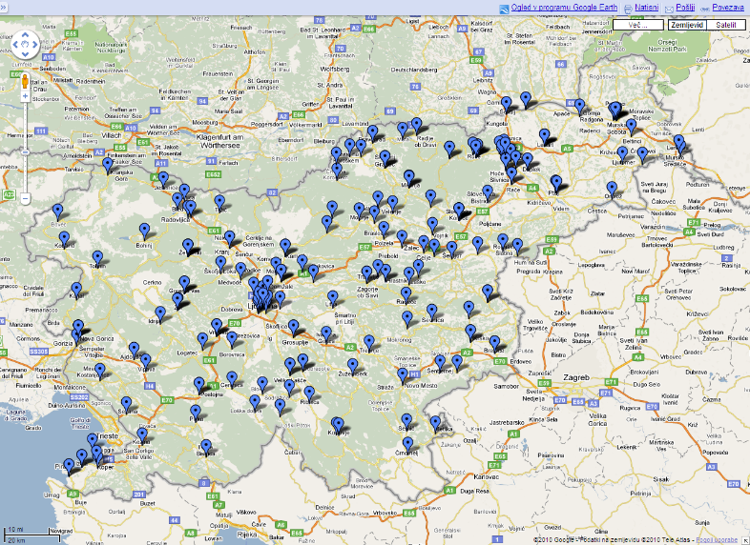
Location and number of child and adolescent health services, Slovenia
GP and family medicine
Child and adolescent
health care services
913
65
300
365
978
Notes:
This slide shows the location of child and adolescents health services in Slovenia. The services is based on primary care services provided by paediatricians. They provide curative, services, preventive services as well as immunization.

Slide 4
Well-child visits: prenatal phase and birth, Slovenia 2015
Prenatal phase:
1st visit in 8th to12th week of pregnancy
2nd visit in 16th week of pregnancy,
3rd visit in 20th to 22nd week of pregnancy,
4th visit in 24th to 26th week of pregnancy,
5th visit in 28th to 30th week of pregnancy,
6th visit in 32nd to 34th week of pregnancy,
weekly visit after 36th of pregnancy
Altogether 10 preventive visits in pregnancy are payed by the obligatory insurance. The provider of care is specialist in obstetrics and gynaecology
Newborn preventive healthcare programme at the maternity hospitals: Two well-baby checks including physical exam, screening and anticipatory guidance carried out after birth and during stay at the maternity hospital by paediatritiana and nurses.

Slide 5
Well-child visits: infancy, early childhood, middle childhood, adolescence, Slovenia 2015
Health visitor visits the mother and the baby the day after they come home from the maternity hospital. Altogether 2 visits of the mother and 6 visits of the baby in the first year.
Well child visits at paediatrician:
Infancy: 1st, 3rd, 6th, 9th month,
Early childhood: 12th, 18th month, 3 years
Middle childhood: 5 years, 6 years (1st grade of primary school), 8 years (3rd grade of primary school)
Adolescence: 11 years (6th grade of primary school), 13 years (8th grade of primary school), 15 years (1st grade of secondary school), 17 years (3rd grade of secondary school).

Slide 6
Well–child visits for infants, children and adolescents
Surveillance of development,
physical examination
Immunizations
Anticipatory guidance
Laboratory tests
Growth monitoring
Health education in health services setting and in kindergartens and schools
Parents
Children and adolescents
Screening

Slide 7
Well-child visits: prenatal phase and birth, Slovenia 2015
 | US | lab | TEOAE | Hip US screening
1st visit |  | +
20 weeks | +
36 weeks | +
40 weeks | - | +
At birth | + |  | + | +
Health authorities in Slovenia recommend an evidence based developmental screening test. If a test is abnormal, there is an agreed referral system.

Slide 8
Well-child visits: infancy, early childhood,, Slovenia 2015
 | H, W | Blood pressure | Denver test | Vision | Lab | US | Vacc.
1 m | + |  | + |  |  |  |  | P, N
2 m | + |  |  |  |  |  |  | N
3 m | + |  | + |  |  | + | + | P, N
4-5 m |  |  |  |  |  |  | + | P, N
6 m | + |  | + |  | + |  | + | P, N
9 m | + |  | + |  |  |  |  | P, N
12m | + |  | + |  |  |  | + | P, N
18 m | + | + | + |  | + |  | + | P, N
3 y | + | + | + | + | + |  |  | P, N, Ps
5 y | + | + | + | + | + |  |  | P, N, Log

Slide 9
Well-child visits: middle childhood, adolescence, Slovenia 2015
 | H,W | Blood pressure | Vision | Hearing | Lab | Vac.
Preschool visit |  |  |  | + |  | + | P, N
1st grade | + | + | + |  |  | + | P, N
3rd grade | + | + | + |  |  | + | P, N
6th grade | + | + | + | + |  | + | P, N
8th grade | + | + | + |  | + |  | P, N
1st grade/sec. | + | + | + |  | + |  | P, N
3rd grade/sec. | + | + | + |  |  | + | P, N

Slide 10
The proportion of children and adolescents that attended the preventive check-up, Slovenia 2011
Notes:
I have mentioned before the preventive care programme for children and adolescents in Slovenia. On this slide I show the proportion of children having preventive health-check at different ages.

Slide 11
Recommended or compulsory?
Visits to well-child care are recommended
Vaccinations are compulsory. In case of non- participation the paediatrician has to report the parents to the health inspectorate. Officially, the participation in vaccination is necessary for enrolment to kindergarten.
Data about coverage, results, cost…
Data are not sufficient.
Evaluation of preventive services using pragmatic evaluation (routine and survey data available, semi-structured interviews, focus group discussions…).
Electronic records
Plans for an e-preventive record and creation of a registry (e-health Slovenia).
Control of coverage of target population planned using population registry.

Slide 12
Which provider is entitled to perform the well-child care
As stated in the law on health care: The providers of preventive services for children and adolescents are primary paediatricians and school-medicine specialists.
Only in exceptional circumstances they can be provided by a GP.
Graduate nurse provides health education. Health visitors, clinical psychologists and speech therapists also give preventive services.
About 30% percentage of the PCPs work-time is dedicated to preventive paediatric health care.
Paediatrician
Nurse
Speech therapist
Clinical psychologist
Health visitor
Graduate nurse
Graduate nurse for helath education

Slide 13
Current situation - challenges in preventive health care in Slovenia
Increasing trends in unhealthy life styles, chronic diseases, mental health problems and related inequalities in health.
Current preventive programmes and arrangements do not ensure inclusion of all target population and equal participation and benefits of preventive healthcare for every person.
Gaps in the current organization and arrangement of preventive health care.
Insufficient programmes and methods for identification and interventions for people at risk.
Present programmes are not adapted enough to vulnerable /disadvantaged groups.
Lack of education and training in preventive programme for all members of the primary paediatric team and for efficient inter-sectoral operation.
Lack of user participation at needs assessment, service planning and evaluation.

Slide 14
Preventive health care for children and adolescents in Slovenia
Weaknesses and gaps of the current system
Lack of human resources; professional demography
Weak evidence base for the extent of the current preventive programme for children and youth
Preventive programme for school children and youth is disregarding non attendants
Insufficient communication between professionals in the health system - education - social care
Inadequate monitoring and evaluation.

Slide 15
In order to achieve the overall objective, the four guiding principles adopted from the WHO European Strategy for child and adolescent health and development are being used in the current NFM project in Slovenia:
Adoption and implementation of packages of effective interventions on child health
Equitable access to quality healthcare services for all children
Strengthening health system support for child health (assessments of health system performance, quality of services, monitoring, health staff development and training)
Ensuring community participation in improving child health.
To enable children and adolescents to reach their full potential for health and development and to reduce the burden of avoidable disease,
reccomendations are:
Life-course approach, from prenatal life to adolescence and adult age
Equity, accounting explicitely for the needs of the disadvantaged
Intersectoral action
Participation of target groups.

Slide 16
Proposed timing of preventive visits:
Prenatal visit at the personal paediatrician and personal health visitor
Newborn baby:
Preventive programme at the maternity hospital
Visits by health visitor (universal and intensive intervention for high risk children)
Infant (1st, 3rd, 6th, 9th, 12th month)
Preschool child (18th month, 3 years, 4,5 years)
School child (individual visit before entry to school, 2nd, 4th, 6th,
8th class)
Adolescent (1st in 3rd grade)

Slide 17
Changes and improvements in the preventive programme (discussed in the current NFM project)
Setting-up the preventive team for children and adolescents and integrated care approach.
Continuity of care and responsive care.
Use of e-health record and preventive services‘summary sheets to improve consistency of communication between health workers.
Use of pre-visit questionnaires and clinical assessment to individualise care and meet the child‘s specific needs appropriate for the level of risk and development.
Summary information for parents with care plan and follow-up plan.
Networking at the local level with kindergartens and schools to respond to the needs of the community, use the available resources and cooperate with other professionals who work with children
Programme for school dropouts to increase the coverage for target population.

