Slide 1

ECPCP meeting -Prague 2015
The Pediatric Practice in Cyprus
2015
Charalambos Hadjigeorgiou MD PhD

Slide 2
Cyprus Health Care
Today status

Slide 3
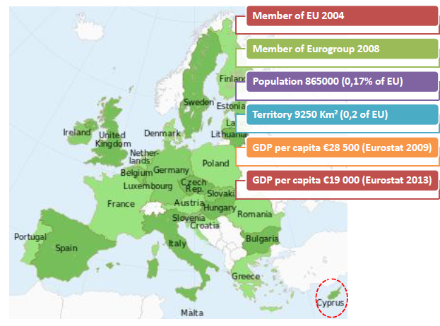

Slide 4
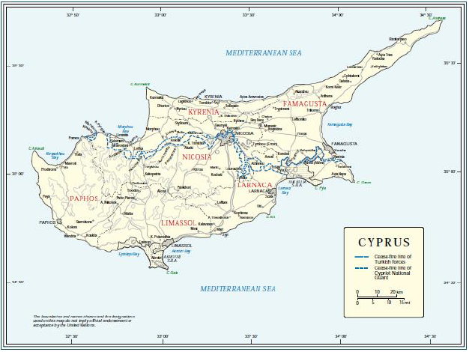

Slide 5
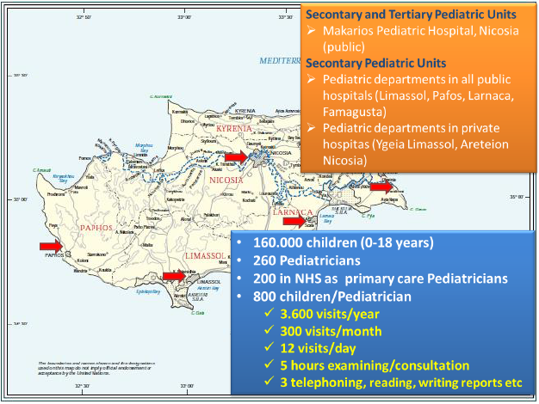

Slide 6
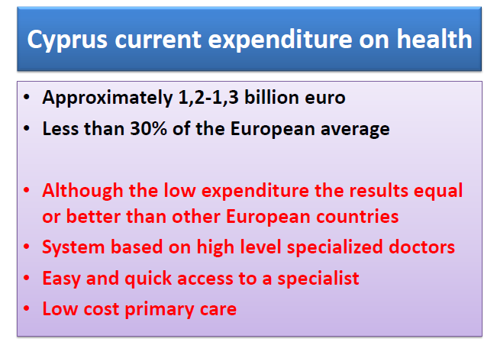

Slide 7
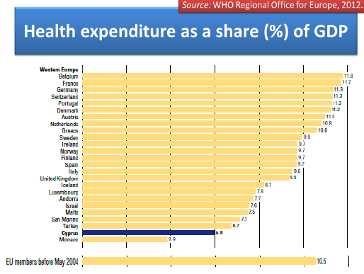

Slide 8
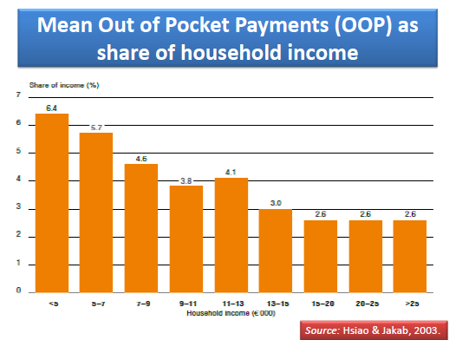

Slide 9
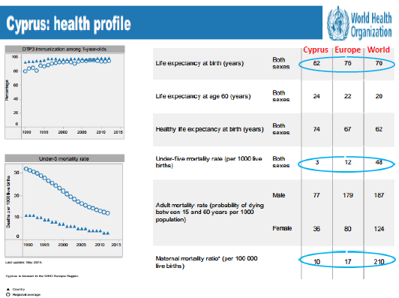

Slide 10
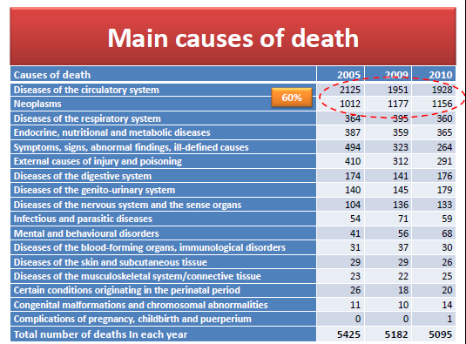

Slide 11
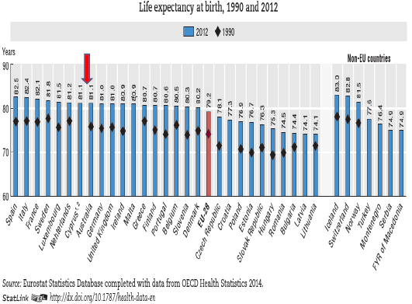

Slide 12
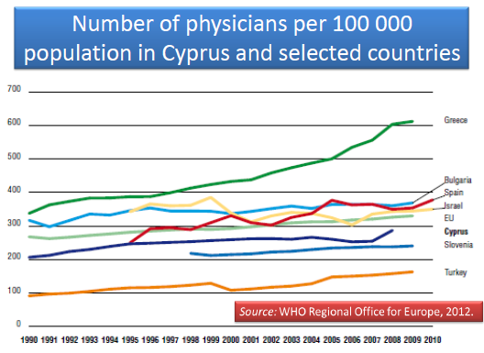

Slide 13
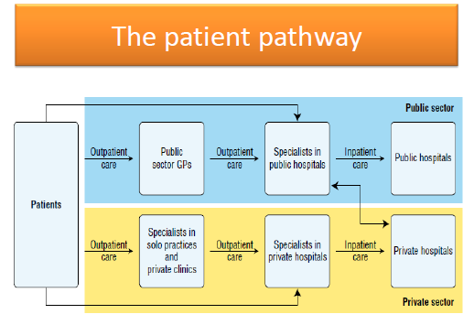

Slide 14
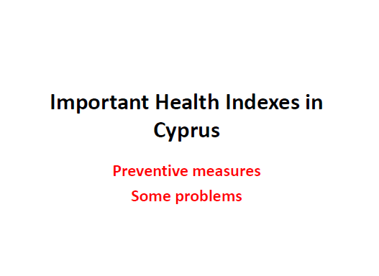

Slide 15
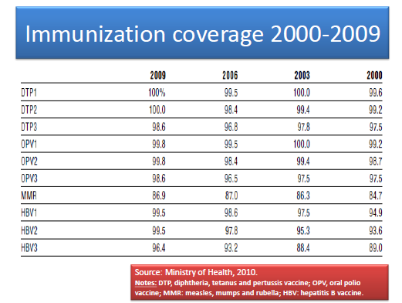

Slide 16
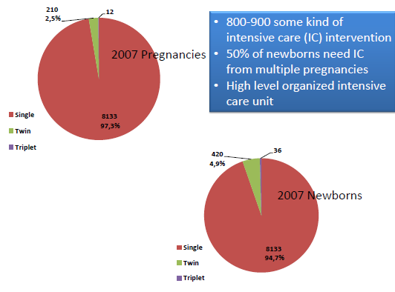

Slide 17
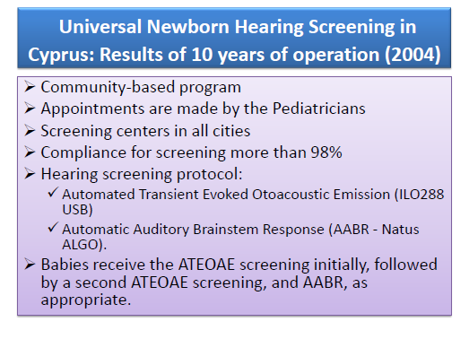

Slide 18
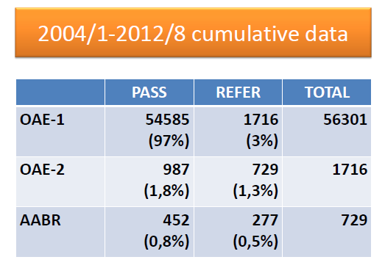

Slide 19
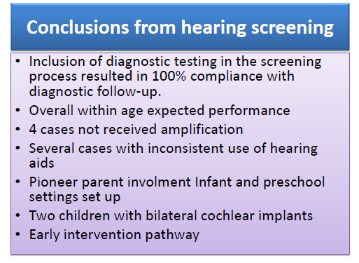

Slide 20
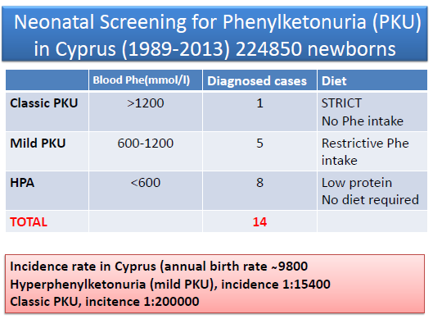

Slide 21
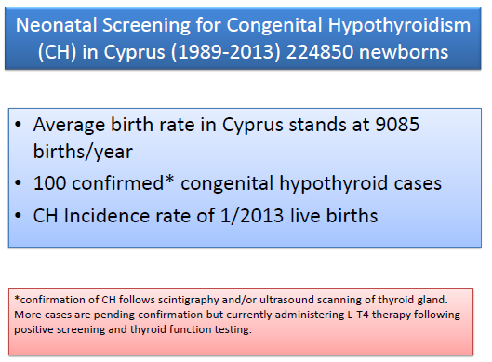

Slide 22
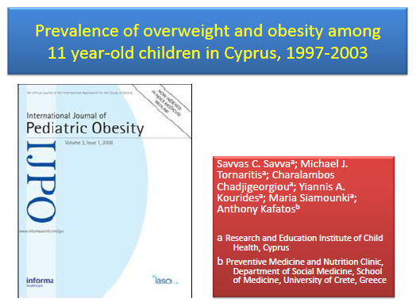

Slide 23
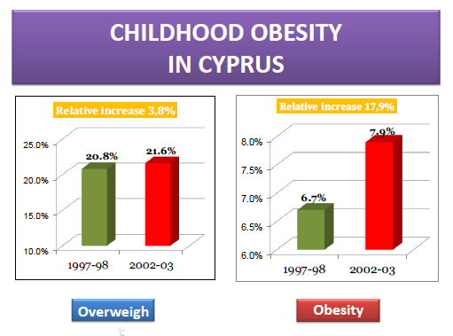

Slide 24
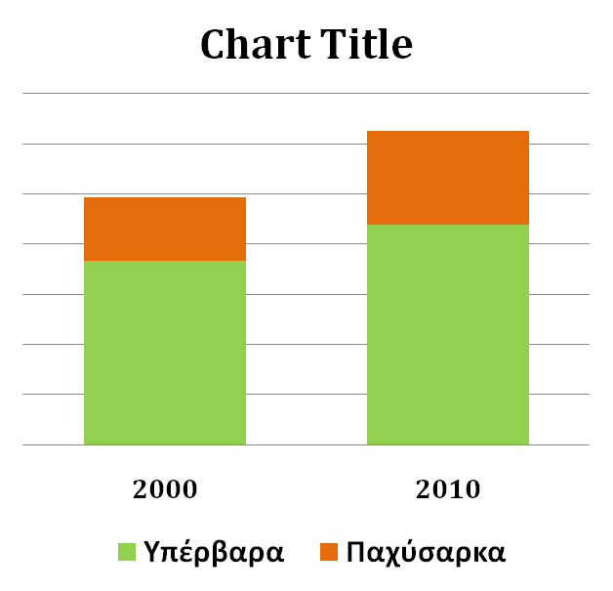

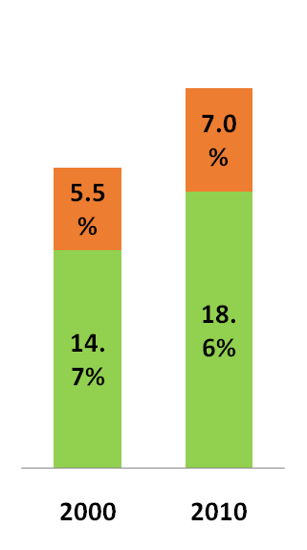
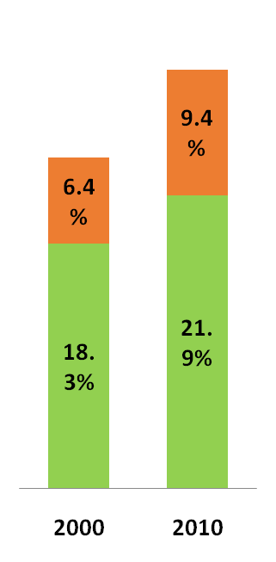
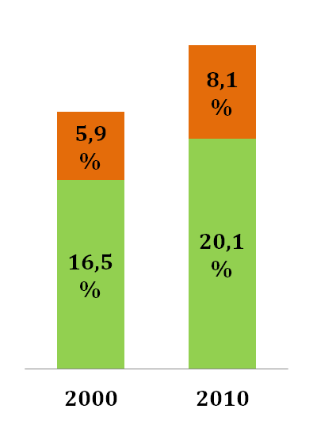
Increase of overweight and obese children
Ages 6-18 years old, 2000-2010
overweight
obesity
% increase in obesity
↑37%
↑47%
↑27%
P<0.001
P<0.001
P=0.043

Slide 25
% Of Overweight and Obese children-adolescents and their parents
Μελέτη iFamily Study

Slide 26
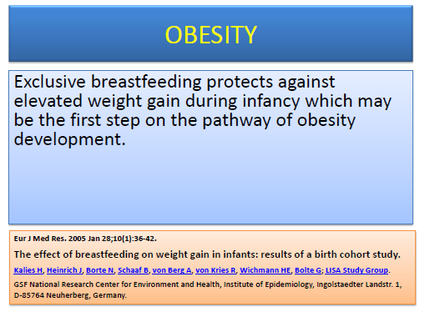

Slide 27
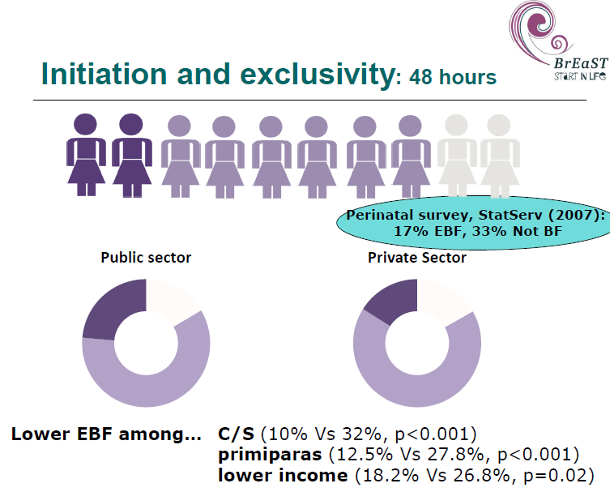

Slide 29
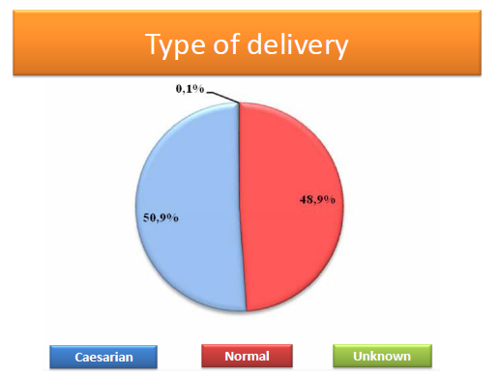

Slide 30
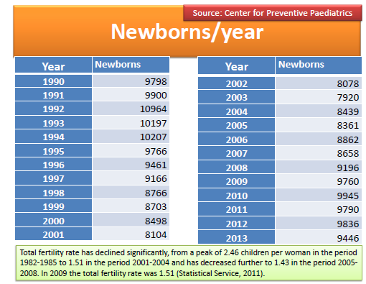

Slide 31


Slide 32
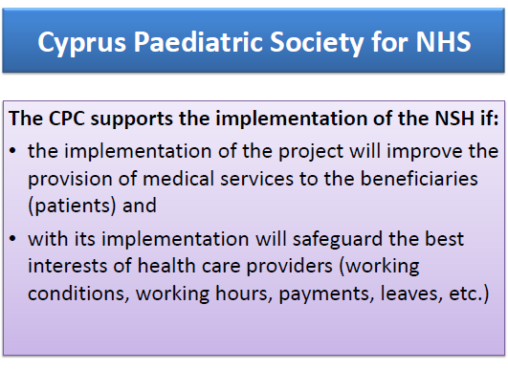

Slide 33


Slide 34
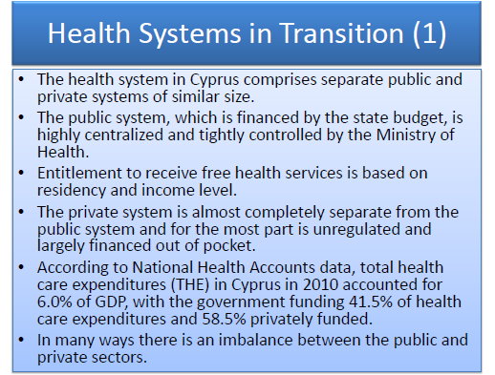

Slide 35
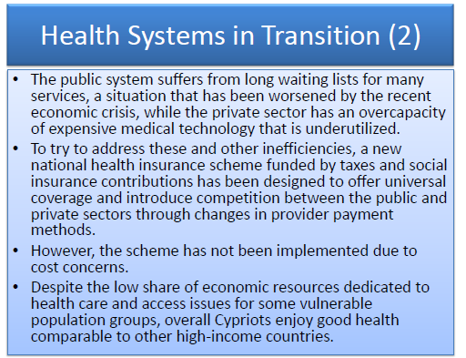

Slide 36
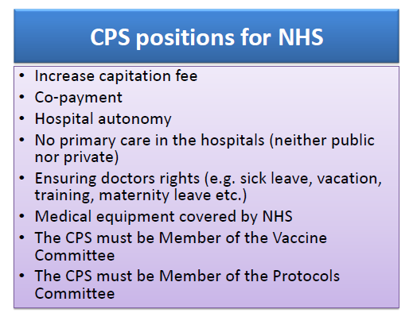

Slide 37
ECPCP should support CPS.
1)The pediatricians should be the doctors off all children-adolescents 0-18 years old.
2)The primary care must be done by private pediatricians with complimentary help for public doctors.
3) The vaccine schedule and others preventing projects (e.g obesity) must be done with collaboration of public and private sectors
4) The NHS must have a reliable and easy
to use software

Slide 38


Slide 39


Slide 40


Slide 41
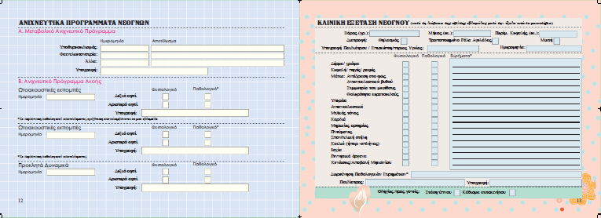

Slide 42


Slide 43
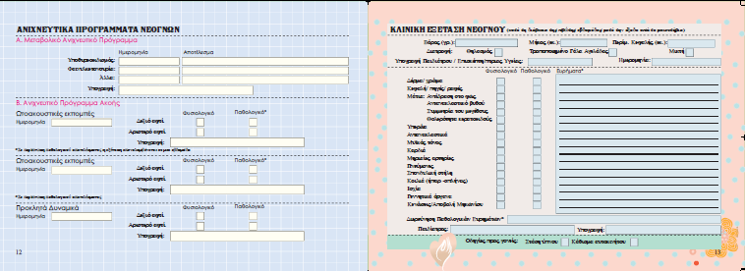

Slide 44


Slide 45


Slide 46


Slide 47


Slide 48


Slide 49
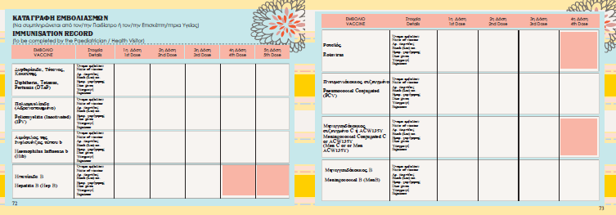

Slide 50
